Slide 1
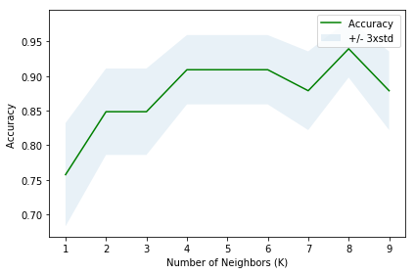
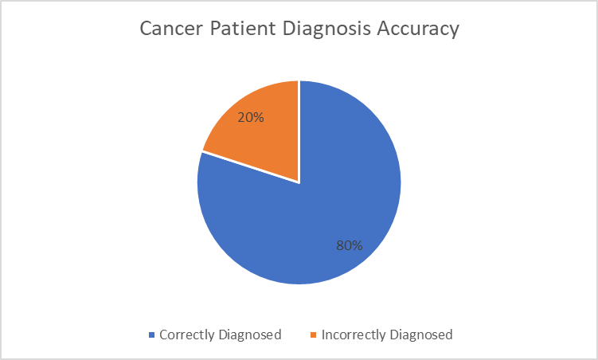
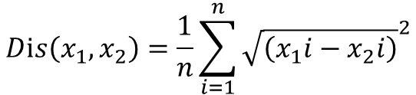

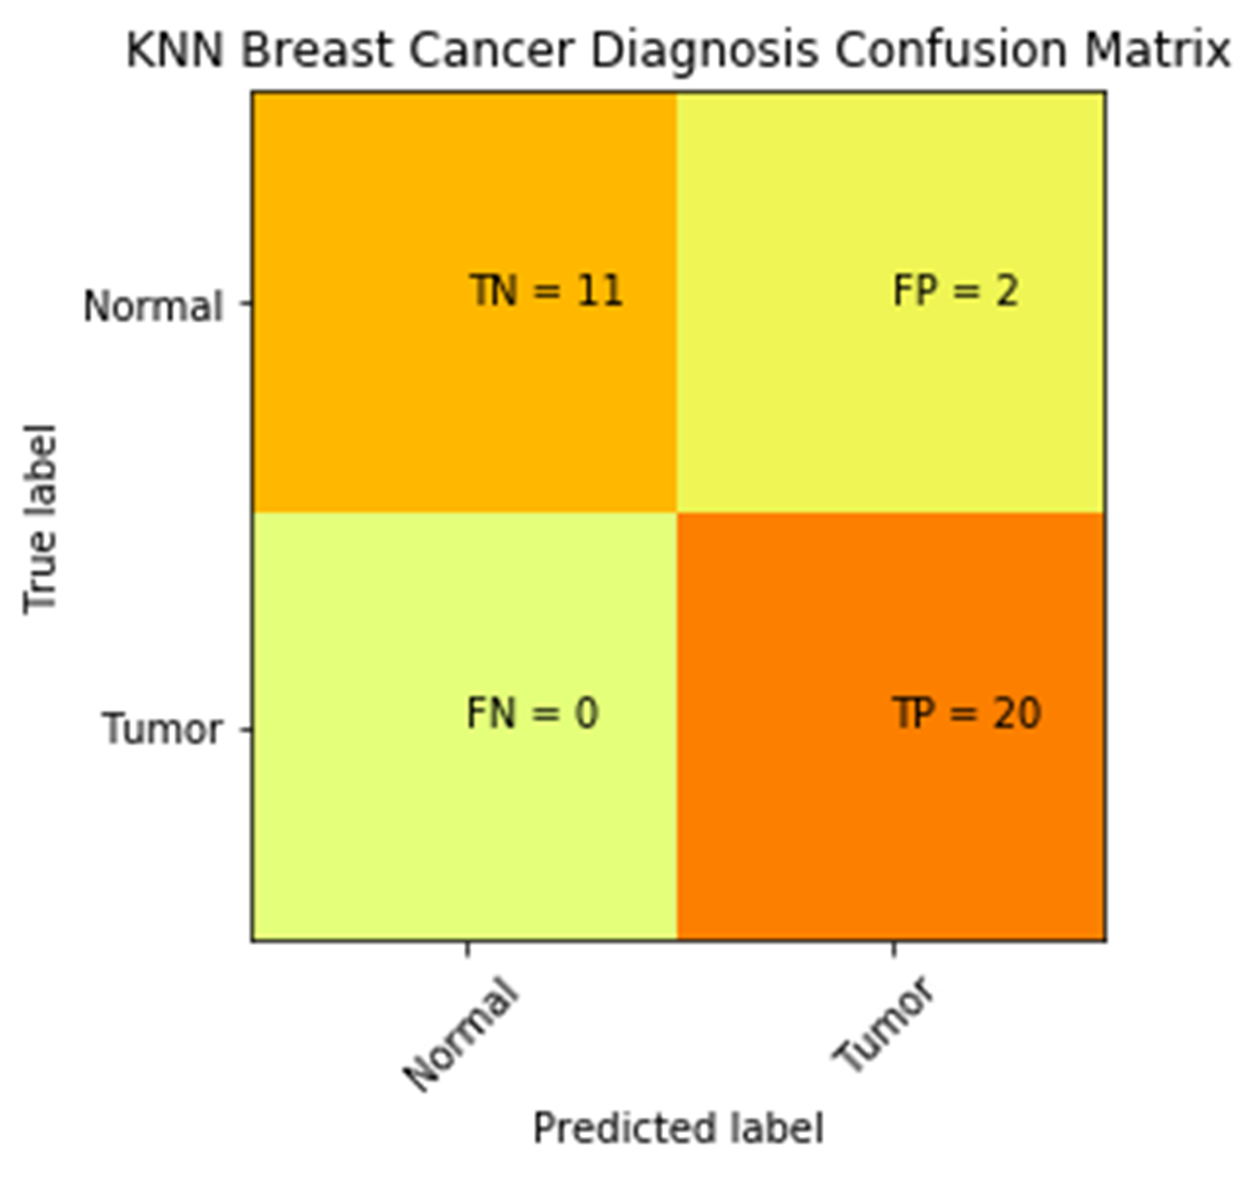
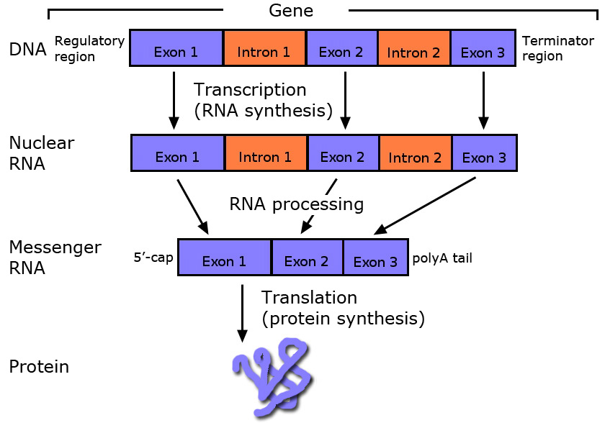
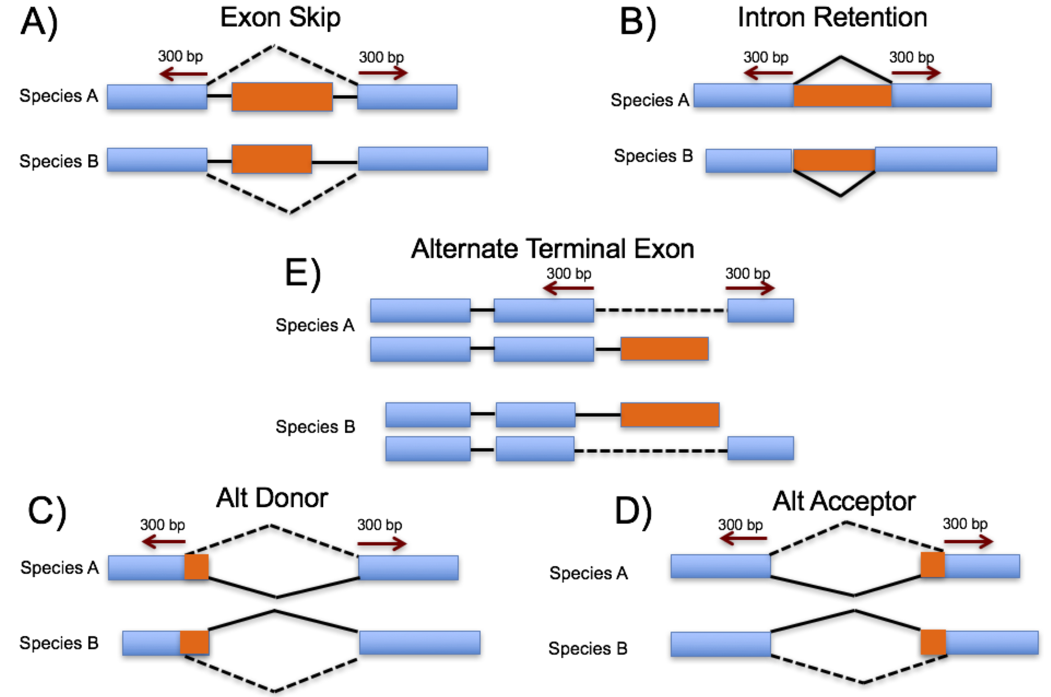
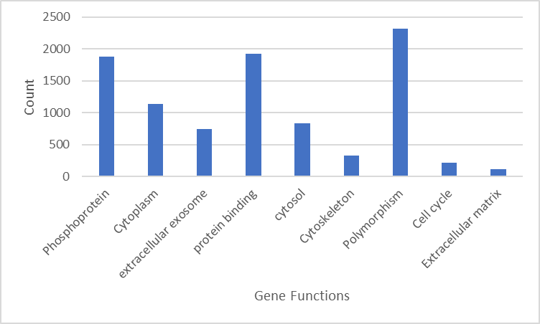
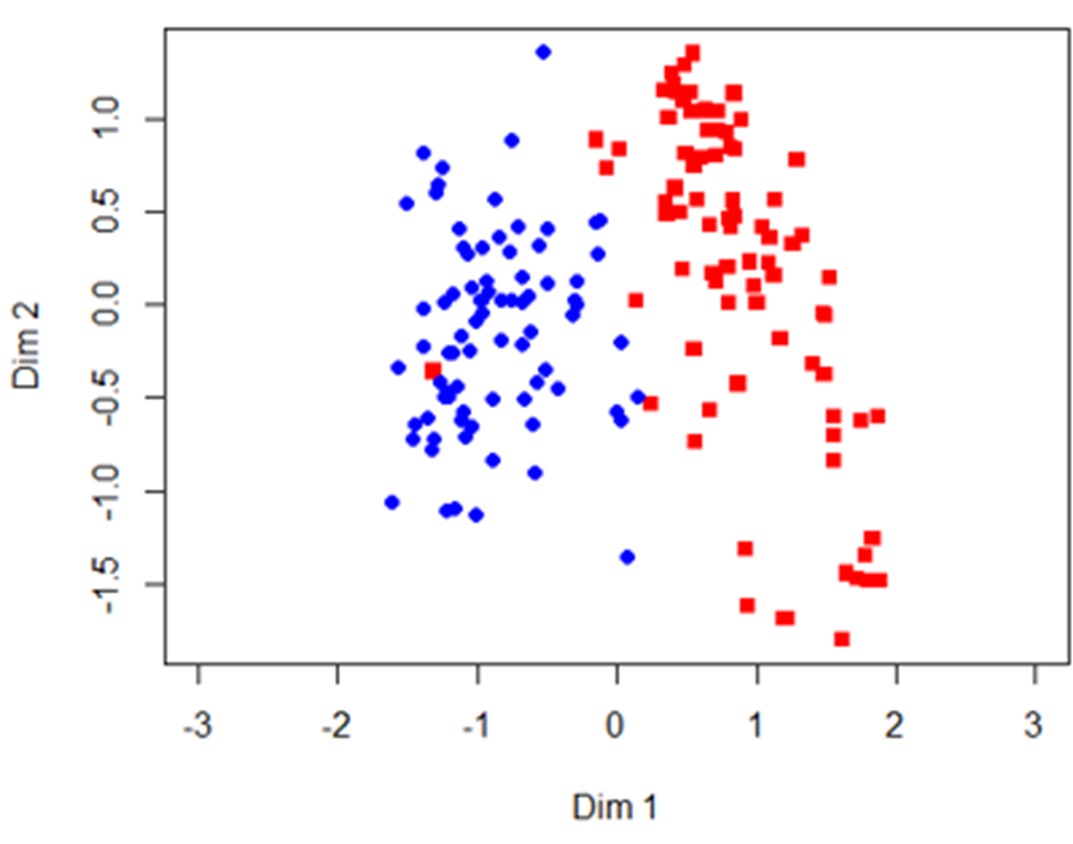
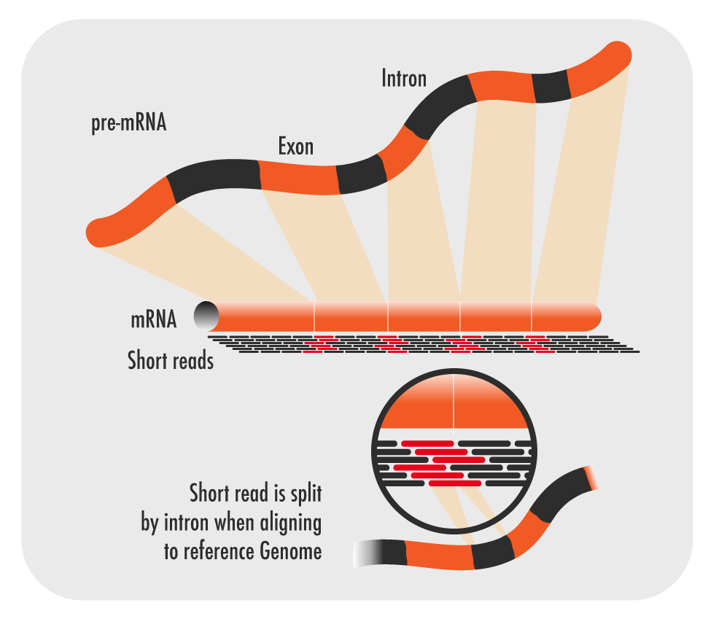
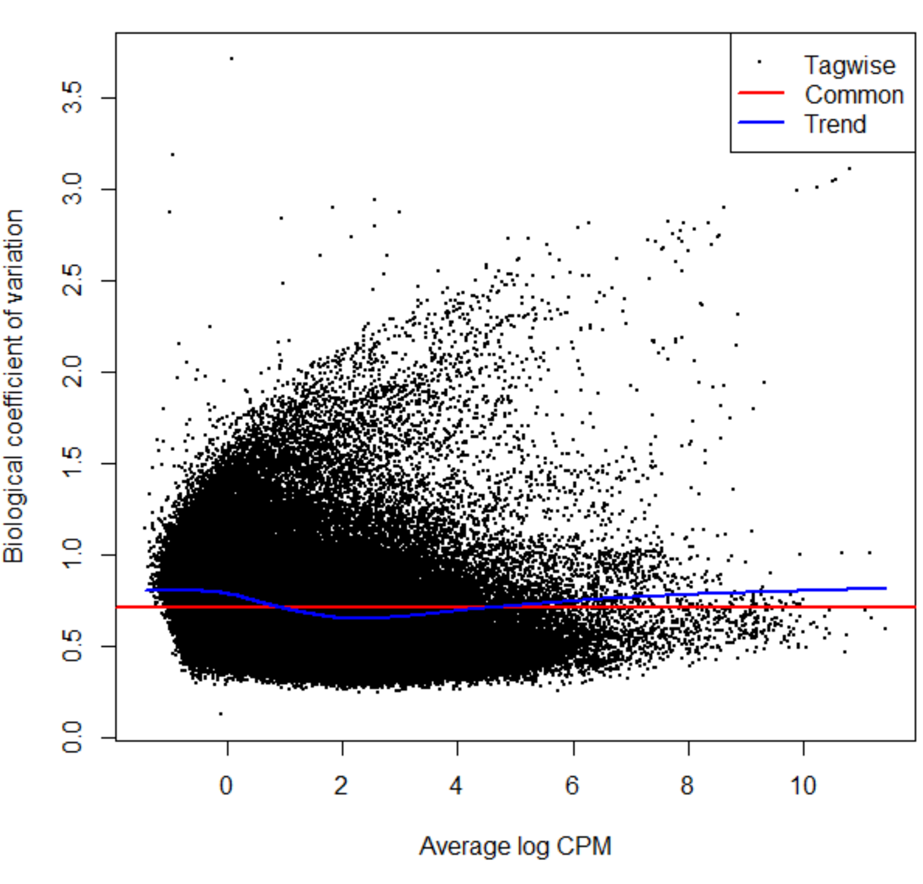
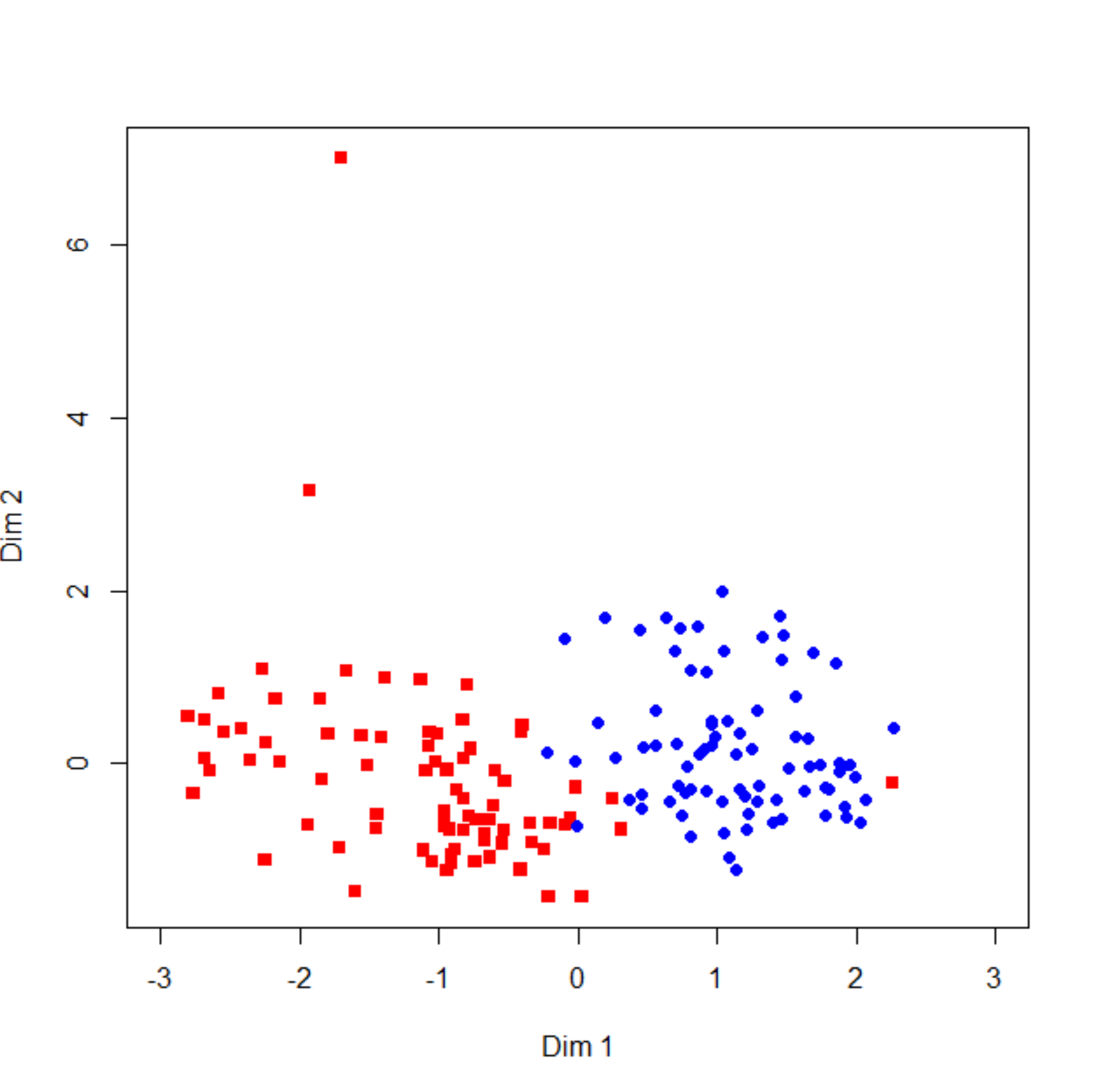
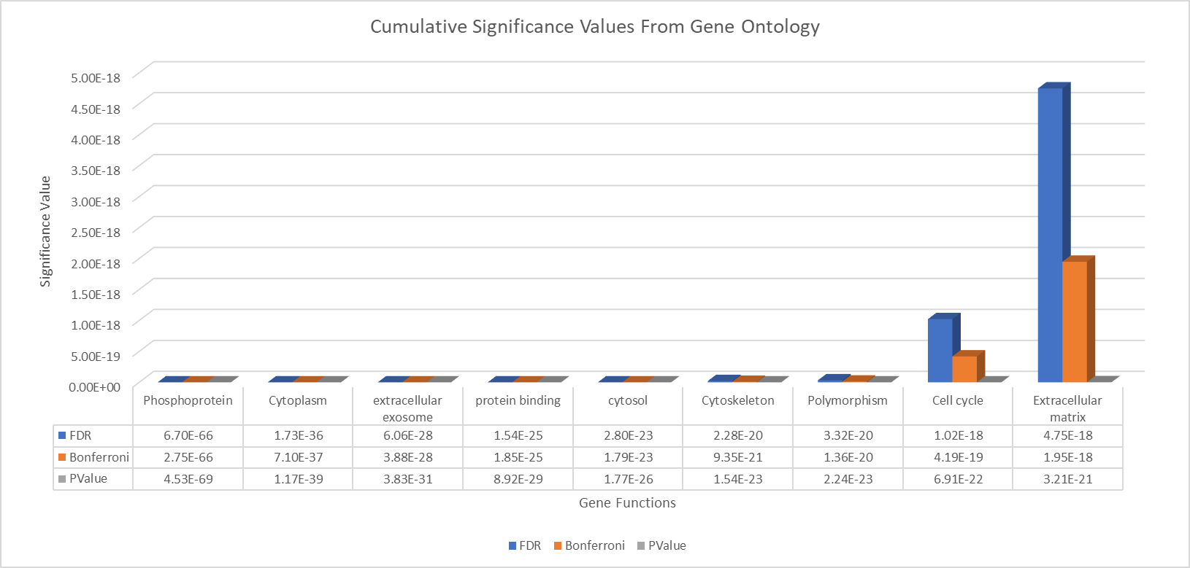
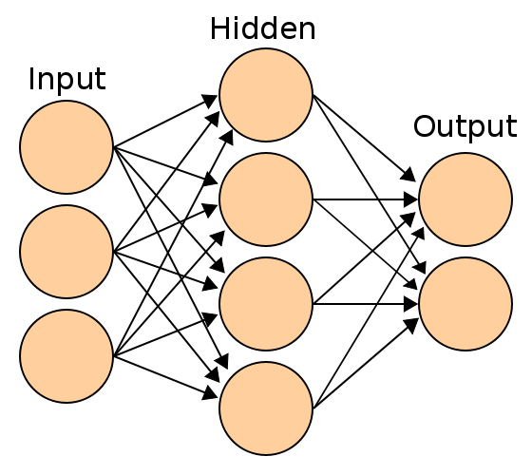
Introduction
Hidden Genes
Detection and Novel Applications of Non-Coding DNA Segments Responsible for Breast Cancer Development and Suppression
Part 2 Results
Problem: Current Breast Cancer Diagnosis Results in Undetected Cancers
Cause:
Mammogram does not detect 1 in 5 cancer patients.
Alternative methods of detection such as ultrasounds, biopsies, or Breast Magnetic Resonance Imaging are either invasive or ineffective
Significance: Breast Cancer is the most commonly diagnosed form of cancer and the leading global cause of death in women, averaging over 1.3 million diagnoses and 458,000 casualties.
Novelty: Implementation of Improved Breast Cancer Diagnostic Tool that is non-invasive and accurate based on Intron Retention in the Central Dogma
K Value Determination
The Accuracy of the KNN Machine Learning Algorithm proved to be the highest when K =8, with a accuracy score of 0.94. The accuracy score was measured by a Jaccard Index.
A Confusion Matrix can further determine the F1 score. The closer the F1 score is to 1, the more accurate the model is. The F1 score is 0.9523, which indicates its high accuracy.
Mammogram Imaging
Manual detection of cysts, fibroadenomas, cancerous and benign tumors
Results in False Negatives and Difficulty in Interpretation
Procedure
Accuracy
Part 1: Detecting Alternative Splicing Patterns
Part 2: Creating a Machine Learning Algorithm to Classify Patients
Number of Neighbors(K)
Step 1: Perform/Collect RNAseq Data from Tumor and Normal Patients
Data Analysis
K Nearest Neighbors (KNN) is a Classification Machine Learning Method. The algorithm works by classifying a data point based on similarities to other data points.
Euclidean Distance can be used to calculate similarities between data points.
K is the number of data points to compare with. K cannot be too large due to potential overfitting, but it cannot be too small; this causes a decrease in accuracy.
In KNN algorithms, the programmer has to analyze which value of K will generate the most accurate model.
Step 1: Calculate Data Normalization Factor
Step 2: Generate Design Matrix
Step 3: Estimate Dispersion Factors
Step 4: Perform QLFTest
Step 2: Find Alternative Splicing Events upon Sequencing Patients
Step 3: Generate Cumulative Matrices of Splicing Event Counts
KNN Breast Cancer Diagnosis Confusion Matrix
DNA Sequencing
Machine Learning Detection of Splicing Events and Differential Expression that suppresses or promotes Tumorigenesis
Results in Early Detection, reduction in False Negatives, and cheaper diagnosis
Step 4: Identify Differentially Expressed Introns
Normal
TN = 11
FP = 2
Background
Step 5: Perform Gene Ontology Analysis
True label
Introns in the Central Dogma
Input Matrices of Counts per File
Select Random-State Train and Test Sets
Select Appropriate K Value
Create Confusion Matrix
Measure Algorithm Accuracy
Tumor
FN = 0
TP = 20
Noncoding DNA segments
Removed during the Transcription phase of Protein Synthesis by spliceosomes
Introns may be alternatively spliced into mRNA.
The inclusion of introns in protein synthesis can be instrumental in tumor suppression and activation.
Analysis is done using a Negative Binomial Distribution Approach
Part 1 Results
Normal
Predicted label
Tumor
https://www.nature.com/scitable/topicpage/regulation-of-mrna-splicing-by-signal-transduction-14128469#
Frequency of Gene Functions that have Differentially Expressed Introns
Biological Coefficient of Variation Scatterplot
Multidimensional Plot for Matched Samples
(patients provide both a normal sample and tumor sample)
Alternative Splicing
Results in multiple protein isoforms
There are five main types of alternative splicing
Constitutive Splicing
Mutually Exclusive Exons
Cassette Alternative Exon
Alternative 3’ Splice Site
Intron Retention
Dim 2
Conclusion
https://www.illumina.com/techniques/sequencing/rna-sequencing.html
The results of the experiment disproved the null hypothesis that there would be no difference between the splicing events that occur in tumor cells and normal cells.
RNAseq
plotMDS command helps visualize multidimensional data into two dimensions.
Complements of RNA are isolated and sequenced using NGS – Next Generation Sequencing
Can detect variances between samples not noticed by DNA microarray technology
Provides digital bytecode data in the form of BAM(Binary Alignment Mapping ) File
Can be converted to Sequence Alignment Mapping File (SAM) through the use of SAM tools
Interpretation: Gene Functions on Graph depict region where differentially expressed introns are mostly found.
Alternative Splicing in specific loci of genes can be instrumental in causing oncogenic development in organisms
Dim 1
Multidimensional Plot for General Samples
DNA segments coding for phosphoproteins, cell cytoplasm, extracellular exosomes, and protein binding are found to have the most DEI’s
https://www.ncbi.nlm.nih.gov/Class/MLACourse/Modules/MolBioReview/alternative_splicing.html
The K Nearest Neighbors Algorithm proved to be more effective at determining cancer patients. With a 100% detection rate and an F1 score of 0.9523
Project Overview
Biological Coefficient of Variation
Dim 2
Experimental Goals
Hypotheses
Null: If splicing events were observed amongst a group of tumor and normal sample cells, there would be no difference or differential expression between the two.
Experimental: If splicing events were observed amongst a group of tumor and normal sample cells, there would be several differentially expressed introns (DEIs) that are found in tumor samples but not normal samples and vice versa.
Project Flowchart
Experimental Goal #1
Analyze and Detect Alternative Splicing Patterns that are instrumental in Tumor Activation or Tumor Suppression
Experimental Goal #2
Develop a Machine Learning Algorithm that can diagnose Breast Cancer accurately and effectively
Average Log CPM
Interpretation: Shape of scatterplot suggests that dataset follows a negative binomial distribution curve. Negative Binomial Probability Distribution stands for the of the number of successes in a sequence of independent and identically distributed Bernoulli trials before a specified number of failures (denoted r) occurs.
Dim 1
Interpretation: Multi-dimensional Scaling (MDS) scatter plot suggests that there is discrepancy between tumor samples and normal samples differential expression
Cumulative Significance Values From Ontology
Future Applications
5.00E-18
Applications to Other Diseases
4.50E-18
Other Genetic Diseases may be affected by differential intron expression
Rare types of cancer i.e.. Neuroblastoma, Pancreatic Cancer
Alzheimer's is not only a difficult condition to treat, but often times, it is extremely difficult to diagnose.
By knowing the differentially expressed introns related to the condition, enzymes such as CRISPR can be used to cut out disease causing segments of a patient’s DNA
4.00E-18
Examine the importance of introns in differentiating cancer samples from normal samples
Identify Alternative Splicing Events that differentiate cancer samples from normal samples
Evaluate the theory that Alternative Splicing of Introns is important in differentiating tumor samples from normal samples through the use of statistical models
Develop Machine Learning Classification Algorithms to classify potential Tumor Patients
3.50E-18
3.00E-18
Significance Value
2.50E-18
2.00E-18
1.50E-18
1.00E-18
5.00E-19
0.00E+00
Phosphoprotein
Cytoplasm
Extracellular Exosomes
Protein Binding
Cytosol
Cytoskeleton
Polymorphism
Cell Cycle
Extracellular Matrix
Utilization of Neural Networks
6.70E-66
1.73E-36
6.06E-28
1.54E-25
2.80E-23
2.28E-20
3.32E-20
1.02E-18
4.75E-18
Allows multiple machine learning algorithms.
As opposed to other machine Learning Algorithms, Neural Networks have the ability to understand complex and non-linear relationships.
Compared to KNN Algorithms, Neural Networks have less Computation Cost
2.75E-66
7.10E-37
3.88E-28
1.85E-25
1.79E-23
9.35E-21
1.36E-20
4.19E-19
1.95E-18
http://pages.cs.wisc.edu/~bolo/shipyard/neural/local.html
4.53E-69
1.17E-39
3.83E-31
8.92E-29
1.77E-26
1.54E-23
2.24E-23
6.91E-22
3.21E-21
FDR
Gene Functions
Bonferroni
P Value
Interpretation: Bonferroni adjusted FDR values and p value show the significance that differentially expressed introns have in each of the gene functions. Genes functioning for creation of phosphoproteins, cytoplasm, extracellular exosomes (vesicles used for extracellular communication) , and protein binding contain the most differentially expressed introns.

